Slide 1
The Issue of Human Trafficking
Mr. Diers – Period 10/11 – Digital Commerce

Slide 2
Issue: What is Human Trafficking
Human trafficking is the process of buying and selling humans, similar to slavery of former years
“Trafficking in persons is a serious crime and a grave violation of human rights,” according to UNODC. “Almost every country in the world is affected by trafficking, whether as a country of origin, transit or destination for victims.”
UNODC is the United Nations Convention against Transnational Organized Crime (UNTOC)
From UNODC.ORG

Slide 3
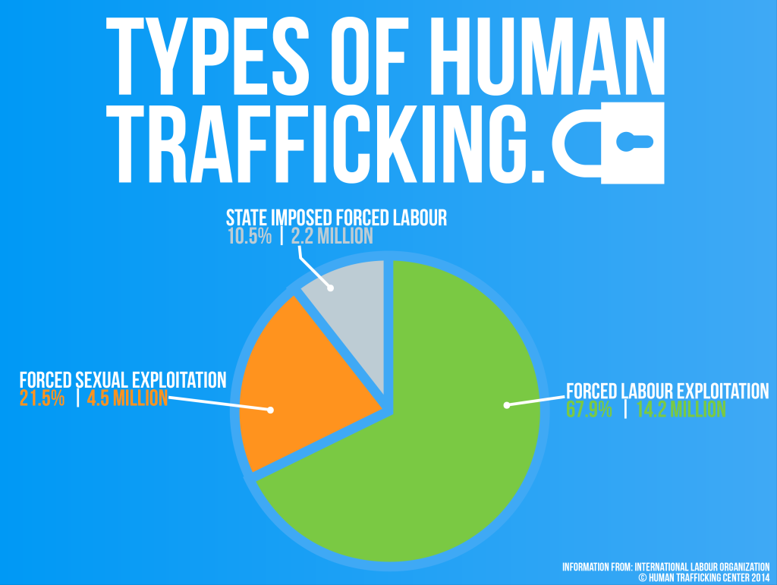
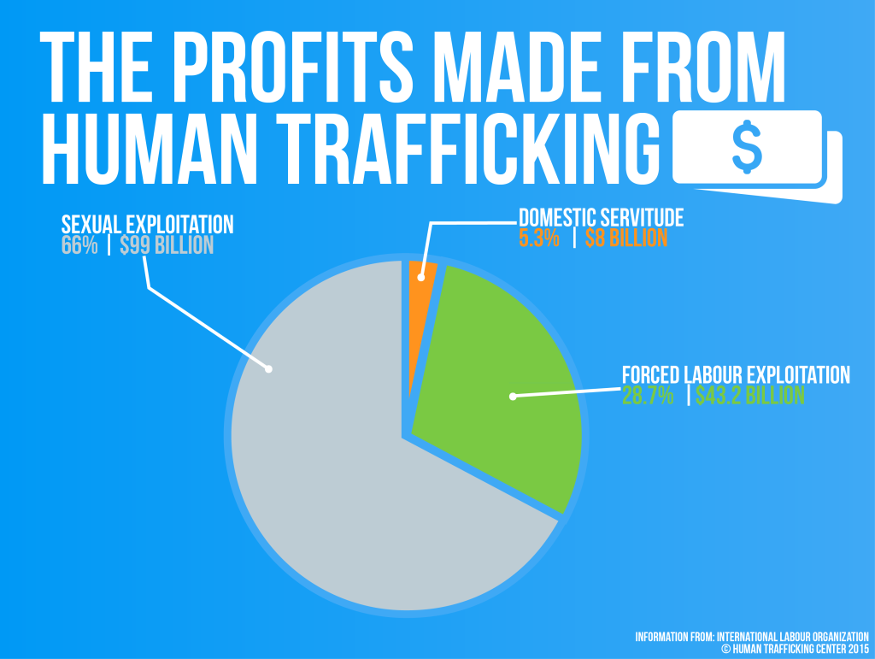
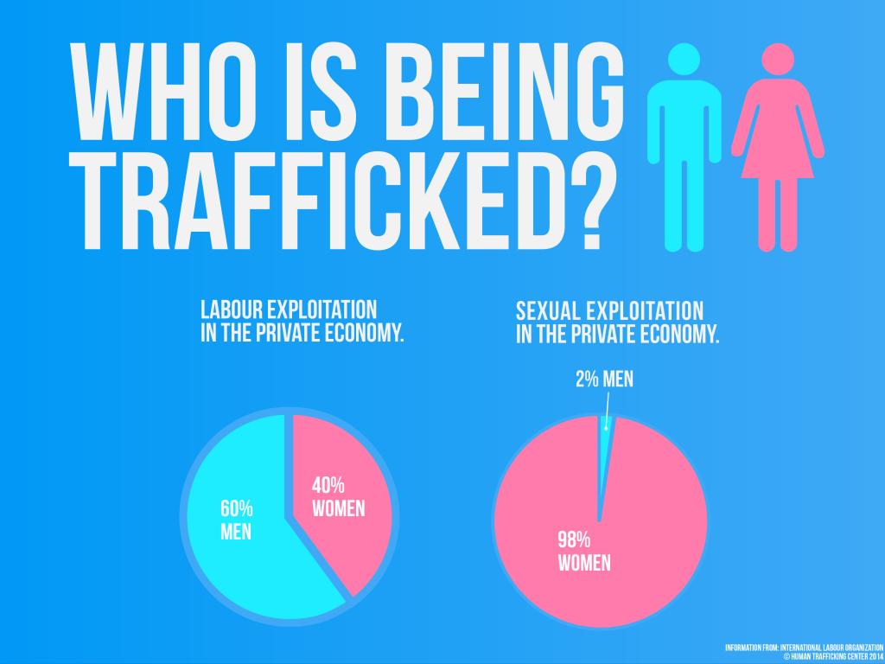
Issue: Why does Human Trafficking Exist?
Human trafficking has existed for the majority of human history, but has just recently moved to the internet.
The majority of human trafficking over the last decade have been carried out exclusively on the internet, for the intentions listed above. By communicating on the internet, transport, capture and sale are much easier than in the past.

Slide 4
Current Approaches
Trafficking Policy and Advocacy: Polaris Project
One of the most influential groups working on the issue in the United States, the Polaris Project takes a comprehensive approach to ending modern-day slavery. The organization advocates for stronger federal and state laws, operates the National Human Trafficking Resource Center hotline , provides services and support for trafficking victims, and works with survivors to develop long-term strategies to ending human trafficking.
Trafficking of Men and Young Boys: Urban Light
A number of organizations help girls in the sex industry, but very few work to aid young men. After a service trip during which she observed the industry in Thailand firsthand, Alezandra Russel realized that boys are often excluded from the human trafficking conversation. So she created Urban Light, an organization that works to help young men break free from child prostitution and sexual exploitation. By providing food, shelter, healthcare, and support services, the group helps restore and rebuild the lives of male victims.
Child Labor: GoodWeave
The handmade rug industry has one of the highest child labor rates in the world. When GoodWeave began its work in 1994, there were nearly one million children—many kidnapped or trafficked—working on the looms in South Asia, often for up to 18 hours a day. Through its efforts, the organization has not only helped bring child labor in the rug industry down 75%, it has built affiliations with retail outlets all over the U.S. to ensure that all carpets sold are free from child labor.
The Issue of Choice: The Empower Foundation
Not all who work in the sex industry do so against their will—some do so by choice. While the resources of most organizations aim to assist those exploited and hidden in the shadows, The Empower Foundation grew from a movement of sex workers and entertainers who fight for fair and sustainable standards and equal rights in the professions they have chosen. The group runs the Can Do Bar , which offers just, safe, and fair conditions for its workers.

Slide 5
What Would I Do?
Role – President of the United States
Action: I would completely outlaw any form of human trafficking. I would also monitor any individual associated with human trafficking, as well as their internet activities and websites.
Any websites linked to human trafficking would be taken down, and all individuals would be sought for and arrested. Working internationally, I would create a database with INTERPOL that assists nations in tracking down individuals associated with human trafficking.
Any individual convicted of human trafficking would be sentenced to a minimum of 50 years in prison, and/or deported to their home nation to receive sentencing in accordance to UN Standards.

Slide 6
Bibliography
https://www.unodc.org/unodc/en/human-trafficking/what-is-human-trafficking.html
https://www.themuse.com/advice/the-fight-for-freedom-7-organizations-combatting-human-trafficking

